Slide 1

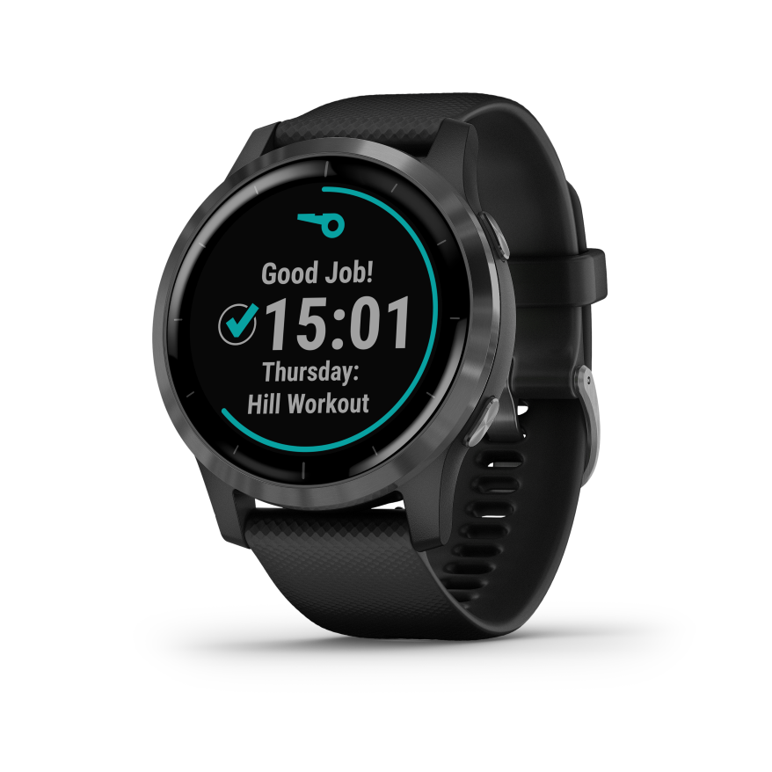
Monkey - C
COMP371 – 09/21/21
Carlos Adrian Bueso

Slide 2
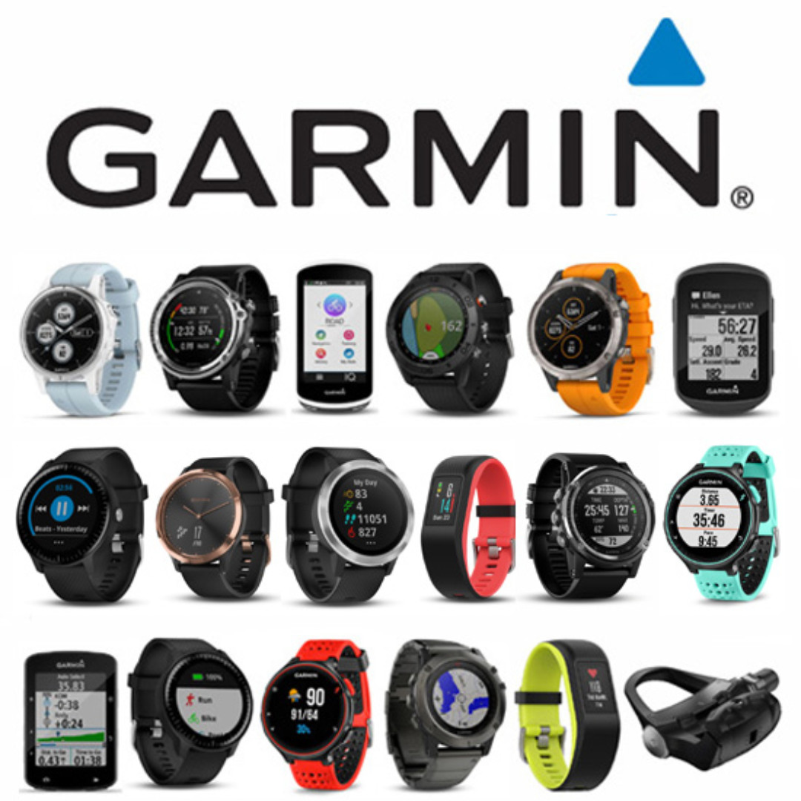
Background
For decades, Garmin has pioneered new GPS navigation and wireless devices and applications that are designed for people who live an active lifestyle. Garmin serves five primary business units, including automotive, aviation, fitness, marine, and outdoor recreation.
Connect IQ (uses Monkey C) launched early in 2015 with the goal of making Garmin devices open to the developer ecosystem and subsequently to consumers for personalizing their devices. Since the launch of Connect IQ, Garmin has launched many more Connect IQ enabled wearables in addition to the first compatible bike computer and handheld GPS unit.

Slide 3

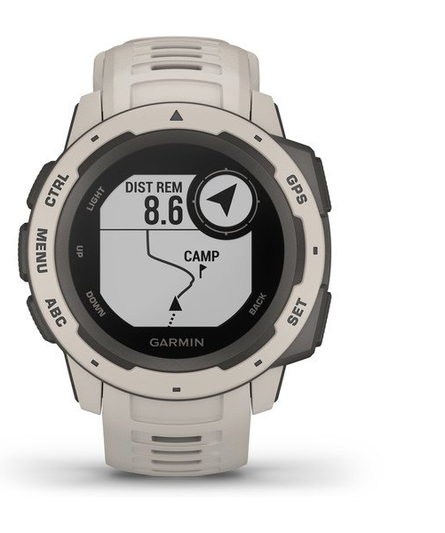
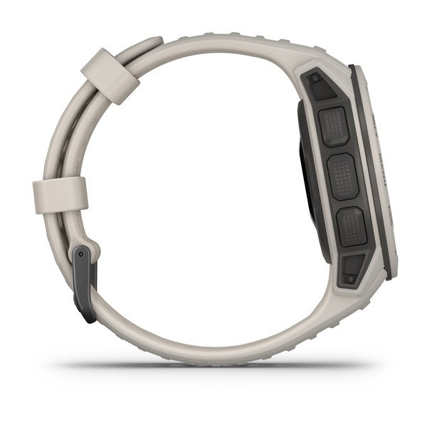
Rationale
Devices allowed: Approach, D2, MK, Fenix, Forerunner, MARQ, Venu, Vivoactive… (+40 products)
Instinct not included.

Slide 4
Code sample – Monkey display
Eclipse IDE plugin.
Plugin Connect IQ (perspective/Monkey C).
SDK for Connect IQ (simulators).
Runs Android Debug Bridge to connect to Android SDK (in command line: adb forward tcp:7381 tcp:7381)
This program uses certain useful features from emulator of Android instance in your Connect IQ application.

Slide 5
Classification
Object-oriented - Like Java, Monkey C compiles into byte code that is interpreted by a virtual machine. Also like Java, all objects are allocated on the heap, and the virtual machine cleans up memory (Java through garbage collection, Monkey C through reference counting). Unlike Java, Monkey C does not have primitive types—integers, floats, and chars are objects. This means primitives can have methods just like other objects.

Slide 6


While Java is a statically typed language, Monkey C is duck typed. In Java, the developer must declare the types for all parameters of a function and declare the return value type. The Java compiler checks these at compile time to ensure type safety. Duck typing is the concept of “if it walks like a duck, and quacks like a duck, then it must be a duck”.

Slide 7
Imperative – Programming with an explicit sequence of commands that update state.
Declarative – Programming by specifying the result you want, not how to get it.
Functional programming - Programming with function calls that avoid any global state.

Slide 8

Design principles
Abstraction - factor out the recurring pattern.
Localized cost - avoid distributed costs.
Preservation of information - allow the representation of information that the user might know and that the compiler might need.
Simplicity - as simple as possible.
Syntactic Consistency - Similar things should look similar.

Slide 9
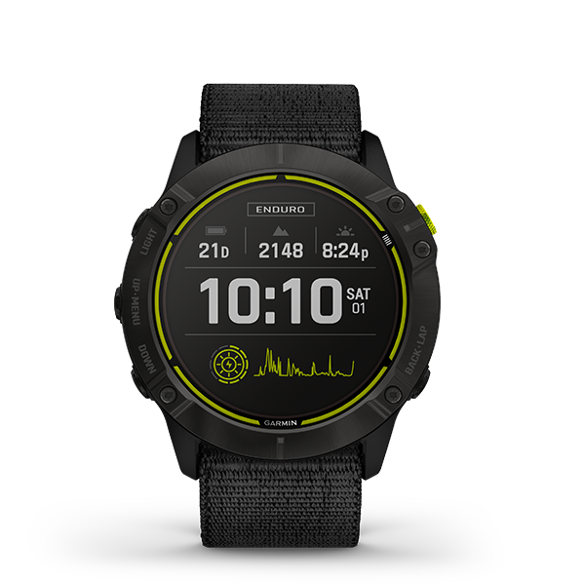
Evaluation
Readability 4.0/5.0
- From Java background; syntax consideration.
Writability 4.0/5.0
- Expressivity, support for abstraction.
Reliability 3.5/5.0
- Eclipse plugin known to be buggy, not a lot of documentation (some people use own VSC environment).
Cost 3.0/5.0
- Eclipse plugin known to be buggy, not a lot of documentation
Others +2.0/0.0
- Cool name and effective/clean OOP development with an integrated testing framework.
Total:
16.5/20.0

Slide 10
Conclusion
I wish you had more access to Garmin open-source development than just this language. Python lets you read data from the module ‘garminconnect’, but its just data collection, not app development for the Garmin device itself. Also, I wish there was more documentation and a bigger community working on Connect IQ and Monkey C projects. “Run no evil”, an automated unit testing framework included (assertions, unit-test). Still, I find the language very useful, simple, and concise to develop small ideas like watch faces, widgets and plugins, and at some extent even apps using object-oriented design.

Slide 11

References
Thank you!
https://poweredtemplate.com/01140/0/index.html
https://developer.garmin.com/connect-iq/compatible-devices/
https://developer.garmin.com/connect-iq/monkey-c/
https://developer.garmin.com/connect-iq/api-docs/index.html
https://www.programmableweb.com/news/how-to-develop-wearable-apps-connect-iq/sponsored-content/2016/10/11
https://fossbytes.com/adb-android-debug-bridge/

